Slide 1


SAP UI5 & FIORI with OData TRAINING
Anubhav Oberoy
Day – 1

Slide 2

INTRODUCTION

Slide 3

Agenda – Day 1
Introduction to SAP UI5
What is SAP UI5?
Evolution of SAP Technologies.
UI5 Development Tools
Installation of development Tools
Introduction to Client Server Architecture
Introduction to HTML
Important Points related to HTML
Structure of HTML
Creating our first page using HTML
Block Level and Inline Elements

Slide 4
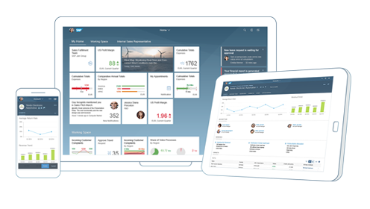

What is SAP UI5?
SAPUI5 (SAP user interface for HTML5) is a collection of libraries that you can use to build desktop and mobile applications that run in a browser. With the SAPUI5 JavaScript toolkit, you can create web applications using HTML5 web development standards.
SAP UI5 is a framework which is used to develop Responsive web applications to run on any platform, any browser and any OS.
Responsive
App which can adapt itself according the different devices
Framework
It’s a collection of Libraries.
Library
Collection of classes.
Classes
Collection of methods, Attributes, Events
Software Innovation
Hardware Innovation

Slide 5
Evolution of SAP UI Technologies
Dynpro
Web Dynpro
WebGUI
BSP
SAPUI5
SAP FIORI 1.0
(2013)
SAP FIORI 2.0
(2016)
SAP FIORI 3.0
(2018)
A Small set of 25 application for tablet and phone
Desktop Scenarios
Native for iOS
More Advanced Features on the launchpad and overview pages
More Scalable content
Machine Learning Techniques Implemented
Native for Android

Slide 6



UI5 Development Tools
Development Tools
BAS is the latest technology provided by SAP for Development
Eclipse
Web IDE
SAP Web IDE comes in two type
Business Application Studio (BAS)
Eclipse development tools is Obsolete
It is no longer supported by the SAP
But we can still use it for local development in our system.
This tool is a Dead technology.
Web IDE Personal Edition
Web IDE Full-Stack
SAP Business Application Studio is the next generation of the iconic SAP Web IDE.
It comes out of the box with predefined set of development environments – Dev-Spaces (virtual machine on the cloud) tailored for developing SAP business scenarios.
It Installs in our local system and runs on the browser.
It requires JAVA 1.8 to be installed in system.
It runs offline.
Support for Web IDE is also stopped by SAP in 2019.
SAP Web IDE Full-Stack runs on SAP Cloud Platform
It needs no installation
It allows you to integrate with other services that run on the platform
SAP Fiori Cloud apps
Git integration
mobile services
IoT services and more.

Slide 7
Installation of the Development Tools
VS code:
VS code a open source development tool (IDE) by Microsoft for developer community. Billions of developers across industry use this tool for all kinds of development (web, android, ERP apps, Fiori). Hence SAP also recommend to follow industry best practice. The BAS is a copy of VS Code (local BAS). If you adopt VS Code, you don’t need to buy SAP BAS subscription so it’s a cost saving for company.
Pre-requisites
Node JS to be installed (min v10) – node –v
Download and install NodeJS from here
We need to install SAP UI5 tooling used by Node JS (support module to work with ui5 apps) – npm install –g @ui5/cli
Steps to install VS Code
Download and install VS Code for free from here
Open the VS Code
Add A folder C:\UI5 Project\basics ← project name
Create webapp/index.html file and same content like Web IDE
Run following command by opening terminal in VS Code and go inside project directory
npm init
ui5 init
6. Inside the webapp folder, create a file manifest.json
7. Start web server using command ui5 serve

Slide 8


UI5 Development Environment
Local Computer
No internet required
Required admin rights to install software
Convenient
Responsible for backup
Faster
Almost no cost
Port application to another PC/laptop manually
System crash everything goes
Hardware cost (8 GB RAM, 100 GB, > i3)
Options
SAP WebIDE (obsolete)
VS Code (recommend)
Cloud Computer
Internet required
No installation required
Convenient (cant develop when offline)
Source code is on cloud
Moderate (depends on speed)
Almost no cost for 365 after that you need to pay
Switch device (suitable for corporate laptops)
System crash wont affect us
Low cost and faster adoption
Options
Business Application Tool (BAS) – 365 days is free

Slide 10
Installation of the Development Tools
Flow to setup the BAS Account.
Click on GO
Create free trial account
Launch your cloud platform
trial cockpit - Click
BAS SETUP
On main screen you will see BAS
Click and Create Dev Space &
choose Fiori as Dev Space Type

Slide 11
Client Server Architecture
The task of the client/server technology components is to provide a reusable runtime environment for other components that use the client server technology as the basis on which to process requests. The focus is on optimizing operating system resources (CPU, memory, etc.), in terms of performance, scalability, and robustness.
In addition to the components in the SAP kernel there are programs that regulate data traffic in the network, such as the SAP router and the SAP Web Dispatcher, as well as smaller monitoring and test programs.
SAP Server Computer on cloud IP Address
Server
149.175.58.1
Request – header + body(optional)
Browser
JS Code
Fiori App
Response – header + body(html, xml, json, excel, pdf, word,….)
Node JS
Request Types
GET – Read Data
POST – Create new Data
PUT – Update
DELETE – Remove Data
ABAP
Java
,NET
Java Script
Form Submit
HTTP Request
Ajax Call

Slide 12

Introduction to HTML
HTML stands for Hyper Text Markup Language, It is used to design static web content. HTML is developed and designed by org named W3C – World Wide Web Consortium.
Markup language is used to define the text document within tag which defines the structure of web pages.
HTML5 is the fifth and current version of HTML. It has improved the markup available for documents and has introduced application programming interfaces(API) and Document Object Model(DOM).
Web Visualization with HTML5, CSS3, and JavaScript is the course with the rapidly changing web development technologies, it has become important to stay in line with them to progress within the industry, which is why this course in web virtualization has been brought to you to spruce up your web designing and animating skills using HTML5, CSS3, and JavaScript.
History of HTML
W3C – World Wide Web Consortium
Year | Version
1990 | HTML
1993 | HTML 2.0
1995 | HTML 3.2
1999 | HTML4
2014 | HTML5
Is a organization and all the browser vendors (chrome, IE, Edge, Firefox) are part of it and comply to w3c standards
https://www.w3schools.com/

Slide 13
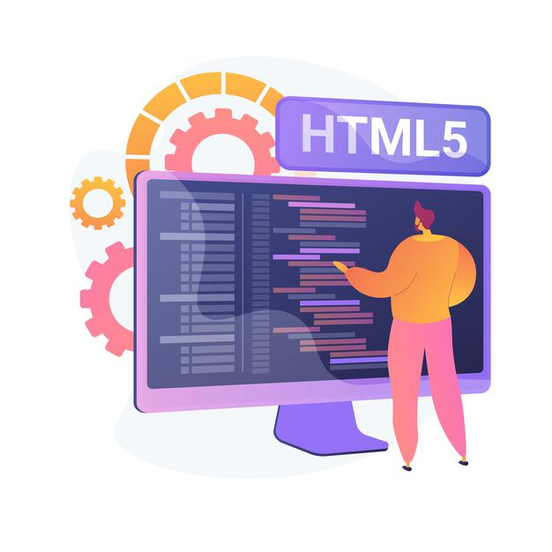
Some Important Points in HTML
HTML pages contains a header and a body, the body is what user sees.
HTML is a tree data structure
Each HTML element is called tag, we will have starting and ending tags.
Syntax
<tagName property=“value”>Content</tagName>
HTML is not a programming language, it’s a markup language.
When we test HTML page in Browser, the generated tree data Structure is known as DOM – Document Object Model.
We can excess the HTML Documentation at https://www.w3schools.com/

Slide 14
Structure of the HTML
<html>
<head>
<title>
</title>
</head>
<body>
</body>
</html>
This is called HTML root element and used to wrap all the code.
This contains the information about the HTML document. For Example, Title of the page, version of HTML, Meta Data etc.
This contains everything you want to display on the Web Page.
<html>: This is called HTML root element and used to wrap all the code.
<head>: Head tag contains metadata, title, page CSS etc. All the HTML elements that can be used inside the <head> element are: <style>, <title>, <base>, <noscript>, <script>, <meta>
<body>: Body tag is used to enclose all the data which a web page has from texts to links. All the content that you see rendered in the browser is contained within this element.

Slide 15
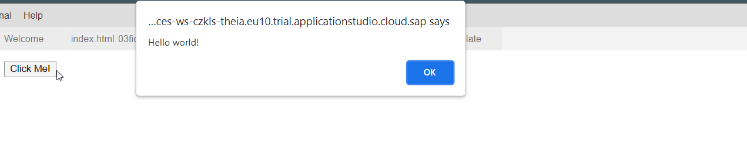
Creating First Program In HTML
Create a Page with a Button using below code:
Code:
<html>
<body>
<button type="button" onclick="alert('Hello world!')">Click Me!</button>
</body>
</html>
You can Copy the code form here: FirstHtmlPage.html
Output:

Slide 16
Introduction to Basic HTML Tags
HTML tags are like keywords which defines that how web browser will format and display the content. HTML tags contain three main parts: opening tag, content and closing tag. But some HTML tags are unclosed tags.
We can see all the available HTML Tags on Documentation at https://www.w3schools.com/tags/default.asp
01
<br>
<li>
<li> tags is used to create a list.
<a>
The <a> tag is used to add link to other tags like text, image etc.,
HTML Tags
<img>
It is used to add an Image to the html Page
<input>
The <input> tag specifies an input field where the user can enter data.
08
<p>
It represents a paragraph in an HTML document

Slide 17

Exercise: Basic HTML Tags
In this exercise we will use a few basic elements like <p>, <h1>, <h2>, <br> tags.
Exercise Code:
index.html

Slide 18
Block Level and Inline Elements in HTML
Block Level Elements
A block-level element always starts on a new line.
A block-level element always takes up the full width available (stretches out to the left and right as far as it can).
A block level element has a top and a bottom margin, whereas an inline element does not.
The <div> element is a block-level element.
div – division tag – it is used to divide screen in multiple group of elements. Every div element always starts with new line.
Here are the some block-level elements in HTML:
<p> <div> <li> <hr> <video> <h1> to <h6> etc.,
Inline Elements
An inline element does not start on a new line.
An inline element only takes up as much width as necessary.
This is a <span> element inside a paragraph.
Here are the inline elements in HTML:
<a> <input> <button> <span> <textarea> etc.,
Block Level Elements
Element 1
Element 2
Element 3
Element 4
Inline Elements
Element 1
Element 2
Element 3
Element 4

Slide 19

Exercise: Image and Anchor Tag
In this exercise we will add a link and an image to the Page.
Using the <a> tag and <img> tag.
<a> tag is used to add link to any other tag in html.
<img> tag is used to add image in the HTML page. For <img> tag we don’t have to put a closing tag.
Exercise Code:
index.html
images

Slide 20

Exercise: List and Form Elements
Exercise: List Elements
Now we will design an ordered list in HTML
Exercise code:
index.html
Exercise: Form Elements
Now we will create a Form using the <form> tag.
Adding some Input fields, Label, Button.
On Button press going on new page.
Passing the form field values on another page.
Exercise code:
index.html

Slide 21

End of Day 1

Slide 22

Questions

Slide 23

Anubhav Oberoy

Slide 24


We’re committed to empower you to be
Most Desirable Resource
through powerful training solutions.
We build the workforce of the future.
250+
Corporate Clients
30,000+
Learners Trained
25000+
Learners Placed
FREE WEBINARS
Sign up for free webinars with industry experts every fortnight!
Enroll Now!
Contact us today!
https://anubhavtrainings.com/

Slide 25




More from AnubhavTrainings.com

Slide 26
Title
Content

